Slide 1

GTM Work Completion and Closure
Duration: 2 Hours
Notes:
Instructor Notes
Do: Welcome the participants to the session.
Say: Welcome to this training on Work Completion and Closure. The duration of this training is 2 hours.
This course will introduce you to the Work Order Completion and Closure process.

Slide 2
Agenda
1
Course Objectives
2
Module 1: Work Order Completion
3
Module 2: Work Order Closure
4
Course Summary
5
Assessment
Notes:
Instructor Notes:
Do: List the modules in the course.
Say: This course has two modules and an end of course assessment. The assessment will test your knowledge of information covered in this course.

Slide 3

Safety Moment

Slide 4






Ground Rules
Please adhere to these guidelines to make it a productive training session:
Join the session and return from breaks on time
Mute your mic if you're not speaking
Focus on training (no multitasking)
Post your questions in the chat window/Q&A Board
Listen attentively
Turn on your video camera as much as possible
Notes:
Instructor Notes
Do: Explain the rules of the training.
Say: Please adhere to these guidelines to make it a productive training session.

Slide 5


Target Audience and Prerequisites
Who should take this course?
Planners
Schedulers
Work Order Lead
Maintenance Management
Systems & Support (MMS)
Plan a Work Order
Approve work order (based on work order
Schedules a Work Order
Executes and completes a Work Order (in Maximo) that will not be scheduled and dispatched in the mobile solution
Resolves Maximo System Errors
Area Supervisor
What are the prerequisites?
Approves a Work Order
Reviews the Work Order completion in ClickMobile for certain work types
Before taking this course, you should have completed the following courses:
Introduction to Maximo* , Work Order Initiation and Planning
*Prior Maximo knowledge is not required
Notes:
Instructor Notes:
Do: Inform participants of the Target Audience for this course and list their responsibilities.
Say: Before taking this course, you should have completed the following course:
Introduction to Maximo* (Prior Maximo knowledge is not required)
Work Order Initiation and Planning

Slide 6

Defining a Work Order Lead
Work Order Leads are responsible for the Work Orders that are not dispatched to Click for scheduling and action-ed within Maximo.
This includes all work completed by external vendors or service providers where the lead coordinates the work and taking it to completion in Maximo.
Notes:
Instructor Notes:
Do: Define a Work Order Lead.

Slide 7
Key Terms
Displayed here are the key terms pertaining to this course.
Acronym | Expansion
Corrective Maintenance (CM) | This Work Order type is used for maintenance tasks performed to correct a fault in an equipment/facility that results in restoration to its intended condition.
Emergent (EMER) | This Work Order type is used for unplanned and unscheduled activities requiring urgent completion to restore operations.
Operational Support (OPSUP) | This Work Order type is used for operational support activities and denotes work not focused on correcting or preventing a fault on equipment.
Predictive Maintenance (PDM) | This Work Order type is used for maintenance tasks carried out based on an analysis of the equipment’s performance or condition.
Preventive Maintenance (PM) | This Work Order type is used for maintenance tasks that are carried out at predetermined intervals or according to prescribed criteria and intended to reduce the probability of failure or the degradation of the functioning of an item.
Work Order | A Work Order specifies a particular task and the labor, materials, services, and tools that are required to complete the task.
Work Order Life Cycle | The chain of events that occur right from when a Work Order is created till the Work Order is closed.
Notes:
Instructor Notes
Do: Inform participants that the key terms used in the course are displayed on this slide. Tell them that they will be familiar with these terms based on their work experience with completing Work Orders and completion of the prerequisite courses. Hence, not much time will be spent on reading contents on this slide.

Slide 8
Course Objectives
By the end of this course, you will be able to:
List the six Work Order types
Identify the roles and responsibilities involved in completing and closing a Work Order
Describe the process for completing and closing a Work Order in Maximo
Demonstrate the Work Completion actions done by the Work Order Lead in Maximo
Describe integration errors
Identify the role responsible for managing integration errors
Notes:
Instructor Notes:
Do: Inform the participants of the course objectives.
Say: By the end of this course, you will be able to:
List the six Work Order types
Identify the roles and responsibilities involved in completing and closing a Work Order
Describe the process for completing and closing a Work Order in Maximo
Demonstrate the Work Completion actions done by the Work Order Lead in Maximo
Describe integration errors
Identify the role responsible for managing integration errors

Slide 9
Work Order Completion
Module 1
Duration: 45 Minutes
Notes:
Instructor Notes
Do: Introduce the participants to the first module.
Say: Welcome to the Work Order Completion module. The duration of this module is 45 minutes. This module will provide you an overview of the Work Completion and Closure process, focusing more on the Work Order completion subprocesses. The Work Order Closure subprocess will be detailed in the next module.

Slide 10
Module Objectives
By the end of this module, you will be able to:
List the six Work Order types
Identify the roles and responsibilities involved in the Work Order Management life cycle
Recognize the four subprocesses that are part of the Work Order Completion and Closure process
Demonstrate the Work Completion actions done by the Work Order Lead in Maximo
Notes:
Instructor Notes:
Do: Inform participants of the module objectives.
Instructor Notes:
Do: Inform the participants of the course objectives.
Say: By the end of this module, you will be able to:
List the six Work Order types
Identify the roles and responsibilities involved in the Work Order Management life cycle
Recognize the four subprocesses that are part of the Work Order Completion and Closure process
Demonstrate the Work Completion actions done by the Work Order Lead in Maximo

Slide 11

Work Order Types
These are the six Work Order types:
Work Orders are based on the work types and subtypes.
Preventive Maintenance (PM)
Emergent (EMER)
Predictive Maintenance (PDM)
Operational Support (OPSUP)
Corrective Maintenance (CM)
Project (PRJ)
You have already learned about each Work Order type in detail in the Maximo Basics for AWM course. Refer to that course for details.
Notes:
Instructor Notes:
Do: List the different Work Order types.
Say: Here are the 6 types of Work Orders. Work Orders are based on the work types and subtypes. I assume you have already learned about the Work Order types in detail in the Introduction to Maximo course. Refer to that course for details.

Slide 12
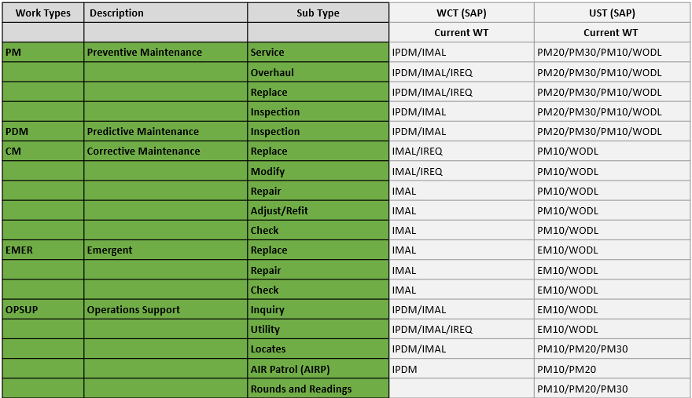
GTM Work Types/Sub Types in Maximo
The graphic below displays a sample list of the Work Types and Sub Types available for use in Maximo, along with the corresponding SAP Types. A more detailed list is available for review in the quick reference guide Maximo Work Types and Sub Types.
Notes:
Difference between SAP and Maximo Work order types. Explaining again that each WT/ST will have its own workflow thus understanding this list is a first step. There will be a training guide that goes along with this to provide more details surrounding the workflow for each WT/ST.
Review – Example – PM/INSPECT

Slide 13
Overview of the Work Order Completion and Closure Process
The following is a high-level Work Order Completion and Closure process. In this course, we focus on the subprocesses that are completed in Maximo.
Automatic Closure
After 180 days, work orders are automatically closed
Operations Technician
Automated Subprocess in Maximo
Start
Completes the field work and updates the Work Order’s status to Field Complete
Does the Work Order require Supervisor’s review?
No
Work Orders that do not require Supervisor's review will change to Complete status though an Automated Maximo process.
Area Supervisor
Automated Subprocess in Maximo
Yes
Reviews/approves certain work orders depending on type
Approves the Work Order and updates its status to Completed
Maximo auto-updates the Work Order’s status to Closed
The Maximo Support Analyst is only involved if there is an integration error
End
Work Order Lead
Receives a Work Order with the Waiting on Completion status
Reviews the Work Order, coordinates with the Contractor, gets data, and updates the Work Order’s status to Field Complete
Start
Work Order Lead
Start
Once the associated PO’s are complete with the Work Order, the Work Order Lead will Complete the Work Order
Legend
Operations Technicians can refer to the Execute Work course while Area Supervisors can refer to the Supervisor’s Activities course to learn about the subprocesses that are completed in ClickMobile.
Action in Maximo
Action in ClickMobile
Notes:
Instructor Notes:
Do: Provide an overview of the Work Order Completion and Closure process. Mention that there is a separate training to review the subprocess completed in ClickMobile.
Say: The subprocesses outlined in Amber are completed in ClickMobile while the subprocesses outlined in Blue are completed in Maximo. In this course, we will focus on the subprocesses that get completed in Maximo. There is a separate training that outlines the subprocesses to be completed in ClickMobile.
The Operations Technician receives a Work Order with the Dispatched status. They review the Work Order details to assess if the Work Order can be completed. If they determine that the Work Order can be completed, they execute the field work and update the Work Order’s status to Field Complete.
Alternatively, for Work Orders that will not be scheduled and dispatched in the mobile solution, the Work Order Lead receives a Work Order with the Waiting on Completion status. They review the Work Order, approve it, and update its status to Field Complete.
The Area Supervisor reviews the Work Order completion details and updates the Work Order’s status to Complete. Note that some Preventative Maintenance Work Orders do not need a Area Supervisor review. So, for PM Work Orders not needing a Area Supervisor review and validation, after the Operations Technician updates the Work Order status to Field Complete, it directly goes to Maximo for auto-closure.
Finally, Maximo auto-updates the Work Order’s status to Closed. This is an automated subprocess in Maximo. The Maximo Support Analyst is only involved if there is an integration error. In case of an integration error, the Maximo Support Analyst will be responsible for changing the Work Order’s status to Closed through an escalation process.

Slide 14
Work Order Completion – Work Order Lead Tasks
The Work Order Lead field is only populated for completing Work Orders that are not scheduled and dispatched in the mobile solution. In such cases, the Work Order Lead is required to coordinate with the Contractor, get data, and finish the work completion actions in Maximo.
Start
Review Work Order details
Communicate Work Order details to the Contractor
Receive a notification from the Contractor that the Work Order has reached the completion milestone or is partially complete
Receive a Work Order with the Waiting on Completion status in the inbox/Assignments
Completion or failure details only
Are the completion or failure and materials used details required?
Initiate the Supply Chain Management (SCM) Self-Service Receiving process in Oracle
Update the status of the Work Order to Field Complete
Enter field completion or failure details
Work Order Lead
End
Initiate the Capture Material Actuals subprocess
Materials used during work
LEGEND
 | Action in Maximo
Notes:
Instructor Notes:
Do: Describe the actions performed by the Work Order Lead to update a Work Order with the Field Complete status.
Say: The Work Order Lead field is only populated for completing Work Orders that will not be scheduled and dispatched in the mobile solution. In such cases, the Work Order Lead is required to coordinate with the Contractor, get data, and finish the work completion actions in Maximo.
In scenarios when the Work Order Lead completes the Work Order Completion subprocess, this subprocess starts when they receive a Work Order with the “Waiting on Completion” status in Maximo. They are required to review the Work Order details and communicate this to the Contractor. The Contractor performs the maintenance work after receiving the purchase order. The Contractor will notify the Work Order Lead when the Work Order Completion milestone is reached or when they partially complete the work.
If the Work Order Completion milestone is reached, the Work Order Lead initiates the Supply Chain Management (SCM) Self-Service Receiving process. After that, the Work Order Lead gets data from the Contractor to enter details about field completion. In cases where the Contractor was unable to complete the maintenance work, the failure details need to be entered in Maximo. Additionally, if the information on the material used needs to be captured, the Work Order Lead initiates the Capture Material Actuals subprocess.
After the Work Order Lead completes entering details about field completion, failure, and materials used, they update the Work Order status to “Field Complete” in Maximo. The role of the Work Order Lead or the Operations Technician in the Work Order Completion process ends here.
After the Work Order status is updated to “Field Complete”, the Area Supervisor receives an action item in their inbox, requiring them to review the field completion details.
We will review the Area Supervisor tasks on the next slide.
Source: The L.P.EMER.02.05 Subprocess (Page-1) tab of the source Visio file LP.EMER.02 Emergent Repair Work Process

Slide 15
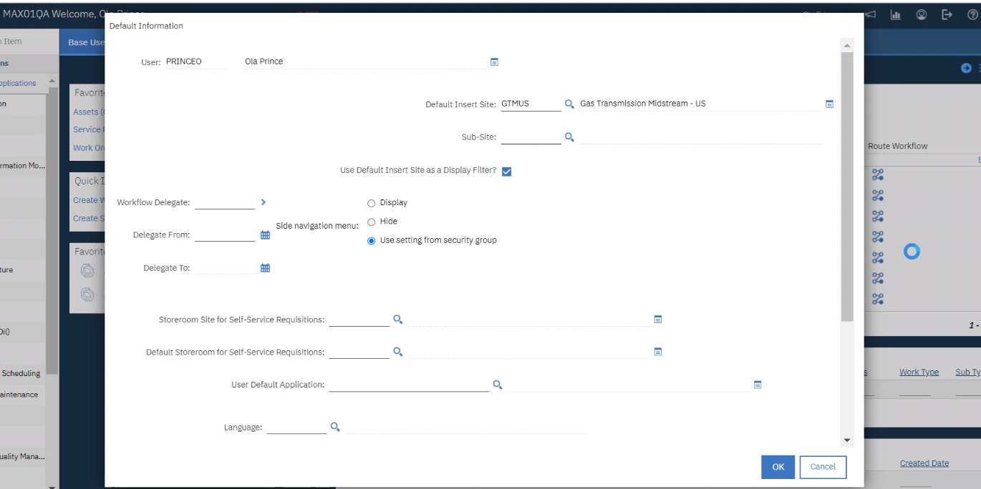
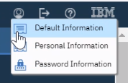
Maximo Navigation – Select a Site
Some users have access to multiple sites (e.g., GTMUS, GTMCAN, etc.). To manage sites, select the Profile icon, then select Default information. Update the Default Insert Site field as required.
Notes:
Instructor Notes
Do: Introduce the participants to the Profile icon and changing their default site.
Say: Clicking the Profile icon allows you to manage your site if necessary. You can change your default site (e.g., GTMUS, GTMCAN, etc.) as needed.

Slide 16
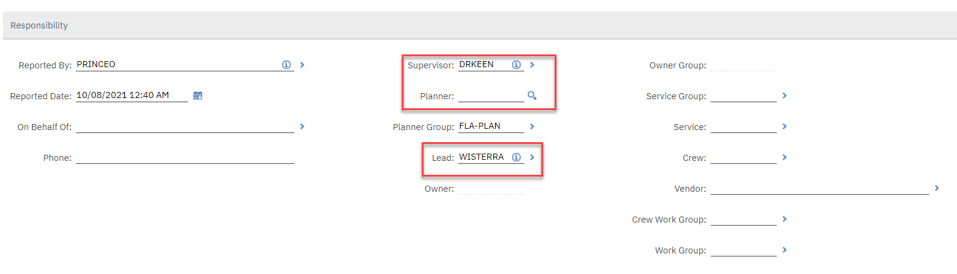
Responsibility section on the Work Order
Update the LEAD in the Responsibility section
Notes:
For this demo, add your name to both fields.

Slide 17
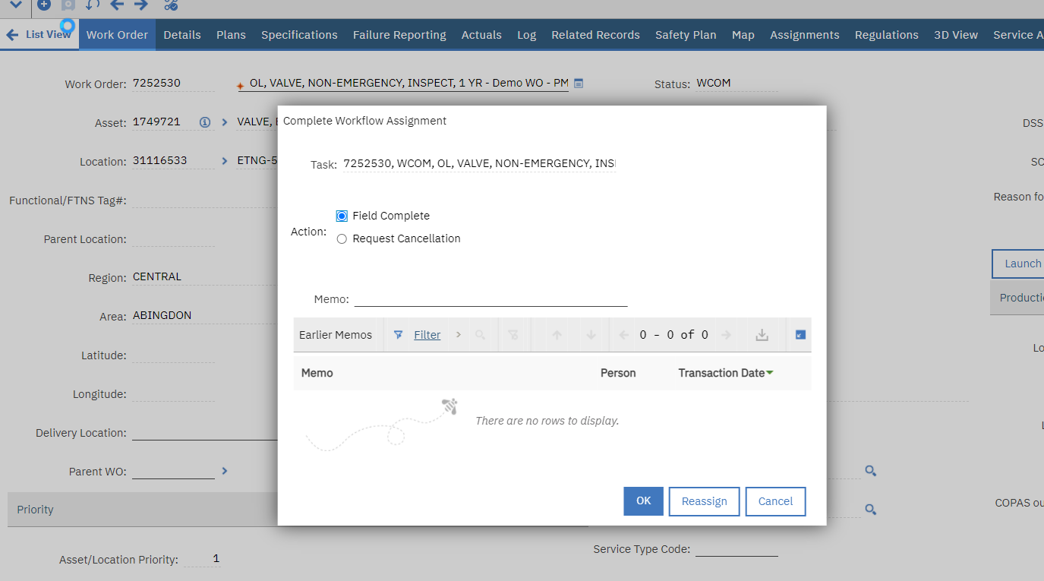
FLDCOMP Status - Work Order in Maximo
The LEAD selects Route Workflow to move status to FLDCOMP

Slide 18
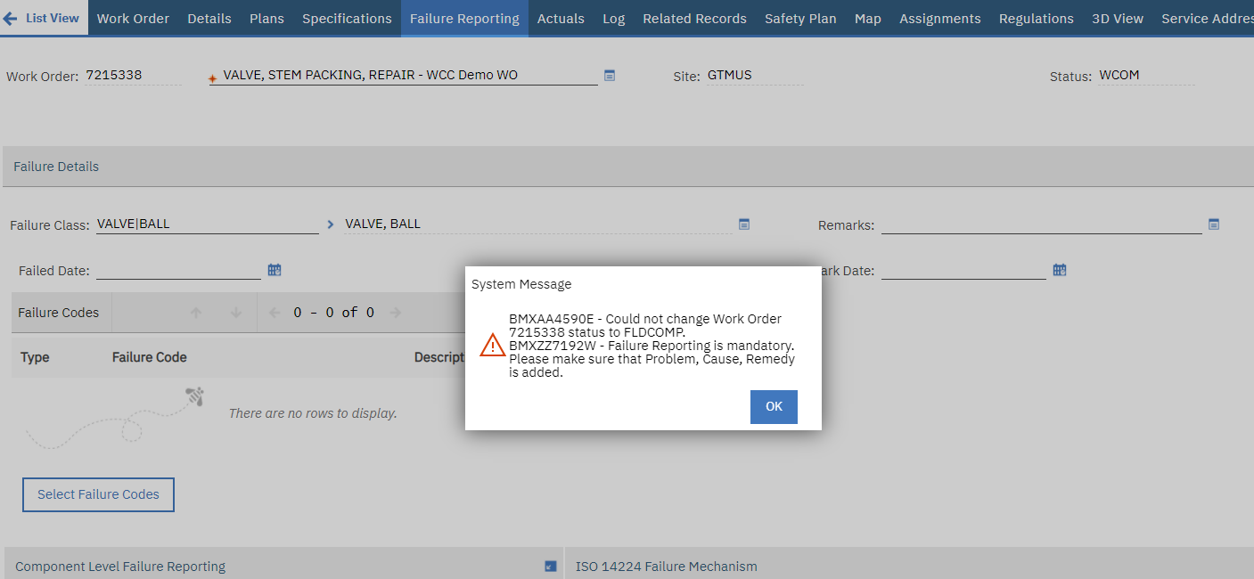
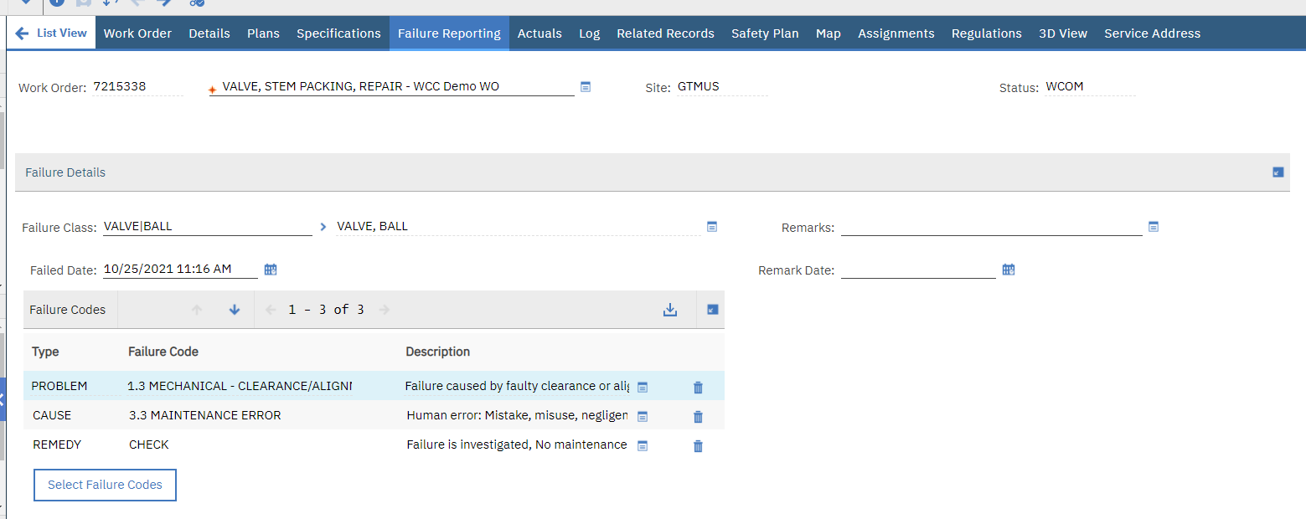
Failure Reporting – Required on CM and EM

Slide 19
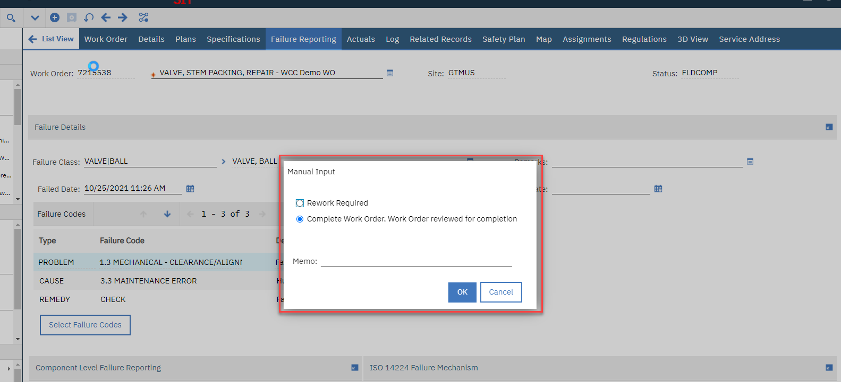
COMP Status work order in Maximo
The Area Supervisor finds the Work Order number in their start center
Select “Complete work order”

Slide 20
Demonstration
Complete a Work Order
Now that you have been introduced to the process of completing a Work Order, let’s look at the step-by-step process for completing a Work Order in Maximo.
The process for completing a work order in Maximo is a specific task managed by the Work Order Lead.
Notes:
Instructor Notes:
Do: Demonstrate the process of completing a Work Order in Maximo.
Say: Steps to change the Work Order Status to Field Complete are performed in the Click mobile workforce management software. So, when the Operations Technician completes the field maintenance task and updates the status in Click, this status change is integrated with Maximo. The Work Order then moves to the Area Supervisor for their review. It is at this stage that the Area Supervisor is required to review the work completion details in the Work Order and confirm approval by changing its status to Complete, in Maximo.
Let’s now look at the step-by-step process for completing a Work Order in Maximo.

Slide 21
Practicum
Complete a Work Order
Scenario: Work Order Lead has received a work order and must complete it to move it to a “Field Complete” status
Notes:
Instructor Notes:
Do: Demonstrate the process of completing a Work Order in Maximo.
Say: Steps to change the Work Order Status to Field Complete are performed in the Click mobile workforce management software. So, when the Operations Technician completes the field maintenance task and updates the status in Click, this status change is integrated with Maximo. The Work Order then moves to the Area Supervisor for their review. It is at this stage that the Area Supervisor is required to review the work completion details in the Work Order and confirm approval by changing its status to Complete, in Maximo.
Let’s now look at the step-by-step process for completing a Work Order in Maximo.

Slide 22
Knowledge Check – 1
Identify if this sentence is true or false.
The Work Order Lead field is only populated for Work Orders that will be scheduled and dispatched in the mobile solution.
True
False
Notes:
Instructor Notes:
Say: Get ready to answer some questions.
Do: Read out the question and the options available.

Slide 23
Knowledge Check – 1
Identify if this sentence is true or false.
The Work Order Lead field is only populated for Work Orders that will be scheduled and dispatched in the mobile solution.
True
False
Notes:
Instructor Notes:
Do: After the participants have responded to the question, explain why option B is correct.
Say: The Work Order Lead field is only populated for completing Work Orders that will not be scheduled and dispatched in the mobile solution. In such cases, the Work Order Lead is required to coordinate with the Contractor, get data, and finish the work completion actions in Maximo.

Slide 24
Knowledge Check – 2
Complete this sentence by identifying the appropriate subprocess and role involved.
In the Work Order process, when the ____ field is completed, the _______receives a Work Order with the Waiting on Completion status.
Owner
Planner
Supervisor
Work Order Lead
Notes:
Instructor Notes:
Do: Read out the question and the options available.

Slide 25
Knowledge Check – 2
Complete this sentence by identifying the appropriate subprocess and role involved.
In the Work Order process, when the ____ field is completed, the _______receives a Work Order with the Waiting on Completion status.
Owner/Supervisor
Planner/Planner
Planner/Supervisor
Work Order Lead/Work Order Lead
Notes:
Instructor Notes:
Do: After the participants have responded to the question, explain why option D is correct.
Say: In the Work Order Completion subprocess, the Work Order Lead receives a Work Order with the “Waiting on Completion” status.
Note: Be sure to mention the Owner is equivalent to the Field Technician.

Slide 26
Work Order Closure
Module 2
Duration: 40 Minutes
Notes:
Instructor Notes
Do: Introduce the participants to the second module.
Say: Welcome to the Work Order Closure module. The duration of this module is 40 minutes. In this module, you will learn about the Work Order Closure subprocess and the associated activities.

Slide 27
Module Objectives
By the end of this module, you will be able to:
Identify Work Order Closure as an automated subprocess in Maximo
Determine the Work Order Closure timeline
Describe integration errors
Identify the role responsible for managing integration errors
Notes:
Instructor Notes:
Do: Inform participants of the module objectives.
Say: By the end of this module, you will be able to:
Identify Work Order Closure as an automated subprocess in Maximo
Determine the Work Order Closure timeline based on whether there is an associated Purchase Order (PO) attached to the Work Order
Describe integration errors
Identify the role responsible for managing integration errors

Slide 28
Work Order Closure Process – Overview
Work Order Closure is an automated subprocess in Maximo. After a Work Order’s status is updated to Completed by the Area Supervisor, it is automatically processed for closure in Maximo. All work orders are automatically closed after 180 days.
Maximo work order status is Complete
Maximo waits for 180 days from the date when the Work Order’s status was changed to Complete
Maximo auto-updates the Work Order’s status to Closed
180
Days
LEGEND
 | Action in Maximo
Notes:
Instructor Notes:
Mention that changes cannot be made after the 180 day period.
Do: Explain the Work Order Closure process to the participants.
Say: Work Order Closure is an automated subprocess in Maximo. If the work order goes to the AS for COMP status, then it will automatically be progressed to COMPLETED by the system. IF the work order is not flagged to go to AS for COMP, it will be COMP’d by a nightly batch job. All work orders are automatically closed after 180 days
It takes about 180 days for the Work Order to close if there are no POs associated with the Work Order. The 180 days are calculated from the date when the Work Order’s status was changed to complete. It will take about 180 days for the Work Order to close if a PO is associated with the Work Order.
Source: The L.P.EMER.02.06 Subprocess (Page-1) tab of the source Visio file LP.EMER.02 Emergent Repair Work Process Visio

Slide 29
Work Order Review Process
Area Supervisors complete a post FLDCOMP review of work orders depending on the Work Type/Sub Type. The following Work Types/Sub Types highlight the Area Supervisors field of responsibility in the process:
Work Type | Sub Type
Corrective Maintenance (CM) | REPLACE MODIFY REPAIR ADRE (Adjust/Refit)
Emergent (EM) | REPLACE REPAIR
Project (PRJ) | All Project Sub Types
Notes:
Instructor Notes
Do: Explain that Area Supervisors only review post FLDCOMP certain work orders and that is based on Work Types/Sub Types
These are not the same as the WT/ST that the supervisor has to APPR in the WIP course.

Slide 30
Demonstration
Completion of a Work Order
Now that you have been introduced to the process of completing a Work Order, let’s look at the step-by-step process for completing a Work Order in Maximo.
This is an action that is managed specifically by the Area Supervisors.
Notes:
Instructor Notes:
Do: Demonstrate the process of completing a Work Order in Maximo.
Say: Steps to change the Work Order Status to Field Complete are performed in the Click mobile workforce management software. So, when the Operations Technician completes the field maintenance task and updates the status in Click, this status change is integrated with Maximo. IF required, the Work order may be reviewed by AS, this task can be completed in both Maximo or Click. (Changing the status to COMP) If this work order will be managed by a Maximo lead, then these next steps will be completed by them.
Note – if you add a Lead (responsibility section) to the work order then this work order will not flow to click and must be completed in Maximo.
Let’s now look at the step-by-step process for completing a Work Order in Maximo.

Slide 31
Practicum
Completion of a Work Order
Scenario: You have received notification that you have a work order that requires review and approval
Notes:
Instructor Notes:
Do: Demonstrate the process of completing a Work Order in Maximo.
Say: Steps to change the Work Order Status to Field Complete are performed in the Click mobile workforce management software. So, when the Operations Technician completes the field maintenance task and updates the status in Click, this status change is integrated with Maximo. The Work Order then moves to the Area Supervisor for their review. It is at this stage that the Area Supervisor is required to review the work completion details in the Work Order and confirm approval by changing its status to Complete, in Maximo.
Let’s now look at the step-by-step process for completing a Work Order in Maximo.

Slide 32
Error Handling – Business Process
Initiated with Service Request
  Routed to MMS team
  MMS to work with Enterprise Work Management and/or TIS
Integration errors
  Identifying errors – various BI dashboards, SNOW incidents, ORACLE cloud management
  Integration errors are synchronization inconsistencies between applications
  Resolving these will be an effort between business sustainment, Enterprise WM and TIS.
Notes:
Integration
Typically, data entered in an application should get synchronized with the other linked application. However, there are times when this does not happen. In such cases, TIS Support must investigate and resolve the issue.
New Process to be created for integration with EWM

Slide 33
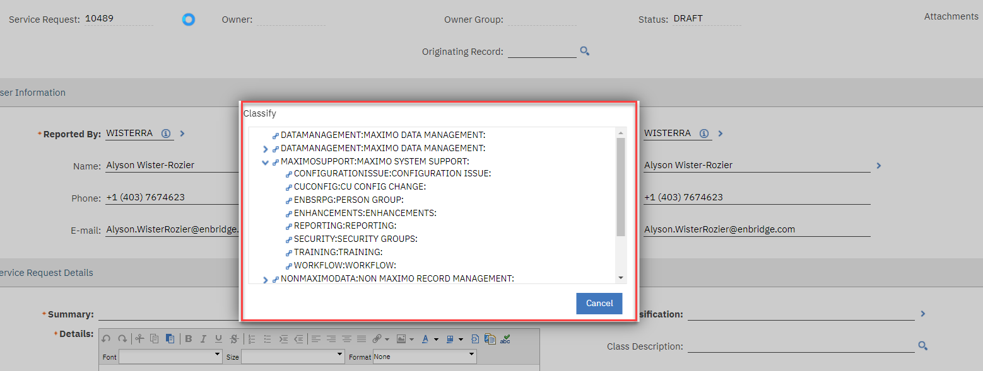
Service Request Classification
Maximo System Support

Slide 34
Knowledge Check
In case of Maximo System Support Service Request, which of these roles is responsible for investigating and resolving the error?
Work Order Lead
Area Supervisor
Maximo Support Analyst
Prerequisite Owner
Notes:
Instructor Notes:
Say: Let’s stopover for a knowledge check to test your understanding of the topics covered in this module.
Do: Read out the question and the options available.

Slide 35
Knowledge Check
In case of integration errors, which of these roles is responsible for investigating and resolving the error?
Work Order Lead
Area Supervisor
Maximo Support Analyst
Prerequisite Owner
Notes:
Instructor Notes:
Do: After the participants have responded to the question, explain why option C is correct.
Say: In case of integration errors, the Maximo Support Analyst must investigate and resolve the error.

Slide 36
Course Summary
Now that you have completed this course, you should be able to:
List the six Work Order types
Identify the roles and responsibilities involved in completing and closing a Work Order
Describe the process for completing and closing a Work Order in Maximo
Demonstrate the Work Completion actions done by the Work Order Lead in Maximo
Describe integration errors
Identify the role responsible for managing integration errors
Notes:
Instructor Notes:
Do: Provide a summary of the key points covered in this course.

Slide 37

Work Completion and Closure
Assessment
Duration: 30 minutes
Notes:
Instructor Notes
Do: Introduce the module.
Say: Finally, let’s begin with Module 3 – Work Order Creation and Planning Practice.

Slide 38
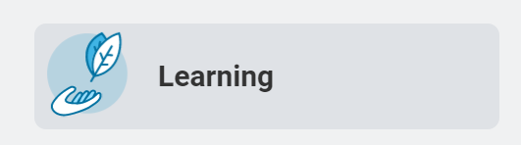
Assessment and Course Evaluation
Thank you for completing the course. In order to receive course credit:
Log in to the Workday Learning Management System (LMS) at workday.enbridge.com, select the Learning App, and select Continue Learning.
Locate and select the name of this course.
Complete both the course assessment and evaluation in order to receive course credit.
Please note that course completion is reported to leadership.
Notes:
Instructor Notes
Do: Introduce the participants to the assessment module of the course.
Say: Welcome to the Work Order Initiation and Planning final course assessment.
The questions in this assessment will test your knowledge and understanding of the Work Order Initiation and Planning process.

Slide 39
Next Steps
Practice:
Prior to go live, be sure to practice the transactions exercised today using the following resources:
  Maximo Training Environment/Training ID: https://maxqa.enbridge.com/
  Login: Network Username and Password
  Web Based Training: UnifyCentral (enbridge.com)
If you have questions:
  Email Unify: unifytraining@enbridge.com
  Unify R3 Portal Site: UnifyCentral (enbridge.com)

Slide 40
Questions?
There are a few ways to get your questions answered:
  Training SharePoint site: Unify Training
  GTM UST Work Management Support Center team: WM Team Support Site
  Super Users: Users that have been involved with the Unify program prior to Go-Live are available to assist with questions.

Slide 41
Thank You

